Slide 1
Advanced ACLs
Chapter 8

Slide 2
Learning Outcomes
Explore advanced security implementations on enterprise networks using various advanced access control lists.

Slide 3
VTY ACLs
In order to control access to routers and switches, we can configure ACLs on the VTY lines to prevent unauthorised users from SSH/Telnetting into the equipment.
R1(config)# access-list 1 permit 172.16.0.0 0.0.255.255
R1(config)# Deny any
Permit the Admin staff on the 172.16.0.0 network to access the router and no one else.
R1(config)#line vty 0 5
R1(config-line)#access-class 1 in
Configures the line to police anyone who tries to login against the access-list and if there is a match of source address, allow them.

Slide 4
Placement of ACLs
Every ACL should be placed where it has the greatest impact on efficiency. The basic rules are:
Extended ACLs - Locate extended ACLs as close as possible to the source of the traffic to be filtered.
Standard ACLs - Because standard ACLs do not specify destination addresses, place them as close to the destination as possible.

Slide 5
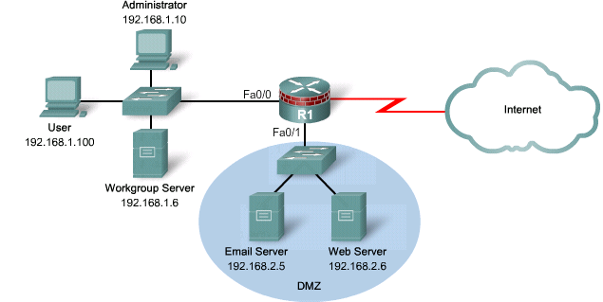
Example of ACL
Create an extended named ACL called ACL-2, applied outgoing on the Fa0/1 DMZ interface, permitting access to the specified Web and Email servers
R1(config)# ip access-list extended ACL-2
R1(config-ext-nacl)# remark DMZ ACL
R1(config-ext-nacl)# permit tcp any host 192.168.2.5 eq 25
R1(config-ext-nacl)# permit tcp any host 192.168.2.6 eq 80
R1(config-ext-nacl)# deny ip any any
R1(config-ext-nacl)# interface Fa0/1
R1(config-if)# ip access-group ACL-2 out
R1(config-if)# exit

Slide 6
Advanced ACLs
Extended IP ACLs using TCP Established
Reflexive ACLs
Time- Based ACLs

Slide 7
TCP Established ACLs
In a modern network all traffic from the outside should be blocked from entering the inside unless:
  It is explicitly permitted by an ACL.
  It is returning traffic initiated from the inside of the network.
Many common applications rely on TCP, which builds a virtual circuit between two endpoints.
Traffic filtering solutions based on the two way connectivity of TCP were introduced:
  TCP Established
  Reflexive ACLs

Slide 8
TCP Established ACLs
In 1995, the first generation IOS traffic filtering solution based on the TCP established keyword for extended IP ACLs.
  The TCP established keyword blocks all traffic coming from the Internet except for the TCP reply traffic associated with established TCP traffic initiated from the inside of the network.
The established keyword forces the router to check whether the TCP ACK control flag is set.
  If the ACK flag is set, the TCP traffic is allowed in.
  If not, it is assumed that the traffic is associated with a new connection initiated from the outside, so it’s dropped.

Slide 9
TCP Established ACLs
Using the established keyword does not implement a stateful firewall on a router.
  The established parameter allows any TCP segments with the appropriate control flag.
  No stateful information is maintained to keep track of traffic initiated from the inside of the network since the router does not keep track of conversations to determine whether the traffic is return traffic associated with a connection initiated from inside the network.

Slide 10
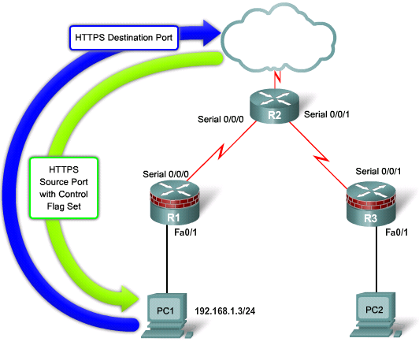
TCP Established ACLs
PC1 is trying to access a webserver on the internet.
R1(config)# access-list 100 permit tcp any eq 443 192.168.1.0 0.0.0.255 established
R1(config)# access-list 100 deny ip any any
R1(config)# interface s0/0/0
R1(config-if)# ip access-group 100 in

Slide 11
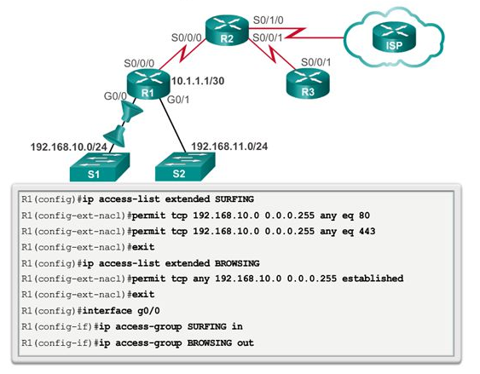
TCP Established ACL another example

Slide 12
Reflexive ACLs
Reflexive ACL’s can be used as a basic kind of ‘stateful’ table on devices to allow traffic back inbound on already established connections.
The reflective part of this feature can only be used on normal traffic flows where the inbound traffic is the same as the traffic that flowed outbound, this means it cannot be used for things like traceroute, VoIP (SIP) calls, FTP (active) and so special considerations should be used for this kind of traffic.
Reflexive ACL’s are configured as a pair and usually applied to the same interface, one in an inbound direction and one in the outbound direction.

Slide 13
Configuring a Reflexive ACL
Step 1.
  Create an ACL that allows internal LAN traffic that is TCP or ICMP to reach the internet and “remember” (reflect) these traffic.
Step 2.
  Create an ACL that evaluates traffic coming from the internet to the LAN. Verify if the traffic matches the “remember” (reflect) list. If there is a match, allow it to go through.
Step 3.
  Activate the ACLs on the same interface going in and out appropriately.

Slide 14
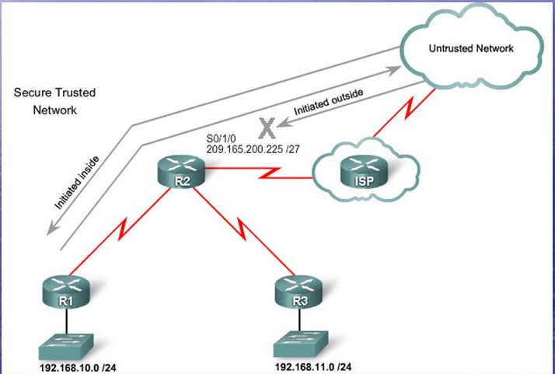
Reflexive ACL example
We want to configure R2 to allow traffic initiated from inside LAN to come back from the ISP.
In this case, we are going to permit TCP and ICMP traffic from inside to go out to the internet. These traffic will be reflected to a list to keep track.
When traffic returns from the internet, R2 will evaluate the traffic against the reflected list and only allow traffic through if there is a match.

Slide 15
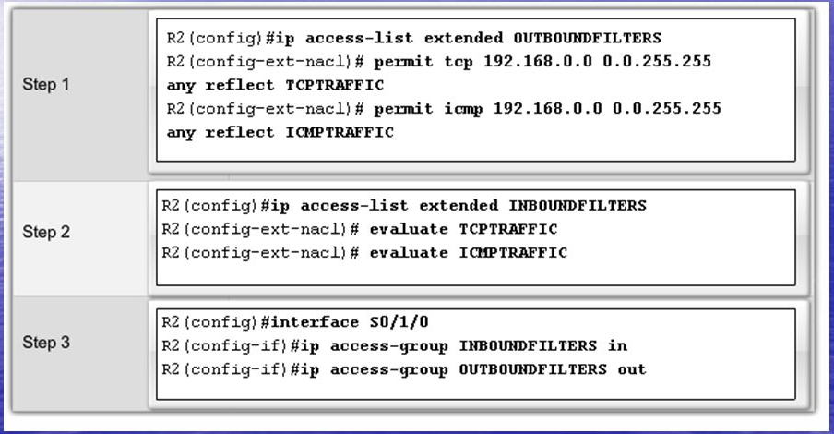
Reflexive ACL Example
These are not real access lists. They are temporary states kept by the router to check incoming traffic against

Slide 16
Configuring reflexive ACL video
https://www.youtube.com/watch?v=kVtkJhWV0Dg

Slide 17
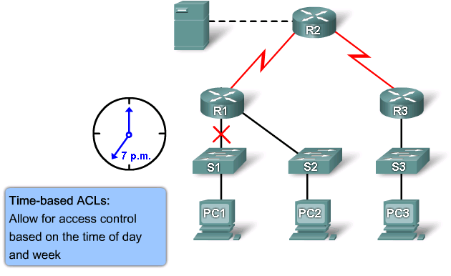
Time-based ACLs
Time-based ACLs allow for access control based on time.

Slide 18
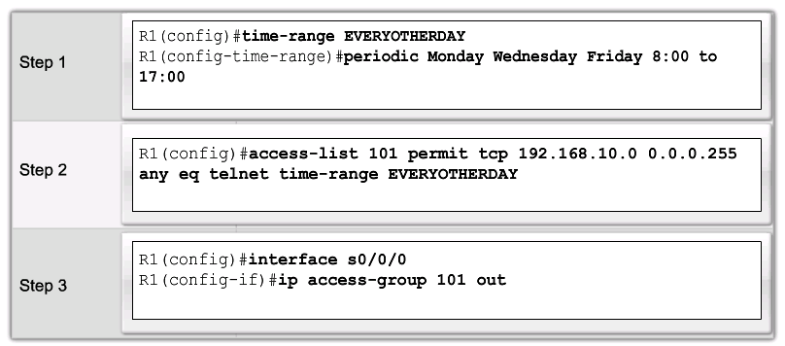
Time-based ACLs
To implement time-based ACLs:
  Create a time range that defines specific times of the day and week.
  Identify the time range with a name and then refer to it by a function.

Slide 19
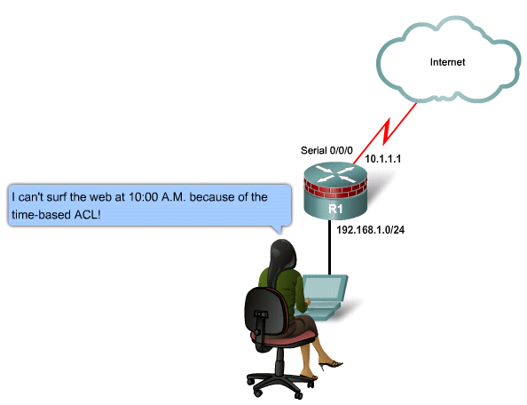
Time-based ACL Example
Users are not allowed to access the Internet during business hours, except during lunch and after hours between 5 p.m. and 7 p.m.
R1(config)# time-range EMPLOYEE-TIME
R1(config-time-range)# periodic weekdays 12:00 to 13:00
R1(config-time-range)# periodic weekdays 17:00 to 19:00
R1(config-time-range)# exit
R1(config)# access-list 100 permit ip 192.168.1.0 0.0.0.255 any time-range EMPLOYEE-TIME
R1(config)# access-list 100 deny ip any any
R1(config)# interface FastEthernet 0/1
R1(config-if)# ip access-group 100 in
R1(config-if)# exit

Slide 20
THE END

